Slide 1

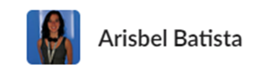



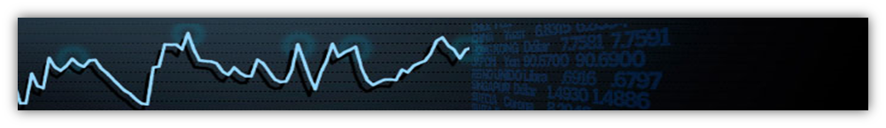
MONASH UNIVERSITY DATA ANALYTICS BOOT CAMP | MELBOURNE
PROJECT#1 - GROUP 8
Group Members:
Project Title: An Outline of Unemployment in Australia
Notes:
Title Slide
Include the name of the Project and Group Members

Slide 2

Motivation & Summary Slide
In this project, we examine overall unemployment in Australia, with special focus to the last three years.
Aim: to analyse the impact of the COVID-19 crises in the unemployment rate in Australia.
Notes:
Define the core message or hypothesis of your project.
Describe the questions you asked, and why you asked them
Describe whether you were able to answer these questions to your satisfaction, and briefly summarize your findings

Slide 3

Motivation & Summary Slide
Our overall hypothesis is to see unemployment had increased to unprecedented levels during COVID-19.
We wanted to see how big that impact was
We wanted dig out subtleties of the impact of COVID-19.
Notes:
Define the core message or hypothesis of your project.
Describe the questions you asked, and why you asked them
Describe whether you were able to answer these questions to your satisfaction, and briefly summarize your findings

Slide 4


Data Sources
Questions
Overall analysis of the unemployment in Australia(10 years)
Short Term analysis of the unemployment in Australia (3 years) by gender
Short Term analysis of the unemployment in Australia(3 years) by state
Section 4: Renzo Bejarano Varela
APIs: https://developer.vic.gov.au/
https://developers.google.com/maps
Other sources: https://github.com/tradingeconomics
Section 1: Ericka Angelopoulos
Section 2: Carmen Jiaman Li
Section 3: Arisbel Batista
Examining if the original Phillips curve is applicable in this scenario (correlation)
Notes:
Elaborate on the questions you asked, describing what kinds of data you needed to answer them, and where you found it

Slide 5
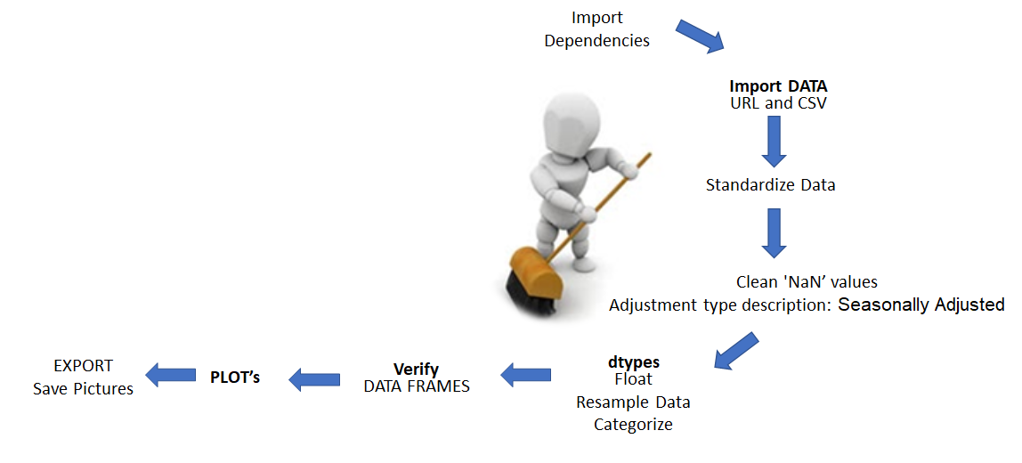
Data Cleanup & Exploration
Notes:
Describe the exploration and cleanup process
Discuss insights you had while exploring the data that you didn't anticipate
Discuss any problems that arose after exploring the data, and how you resolved them
Present and discuss interesting figures developed during exploration, ideally with the help of Jupyter Notebook

Slide 6
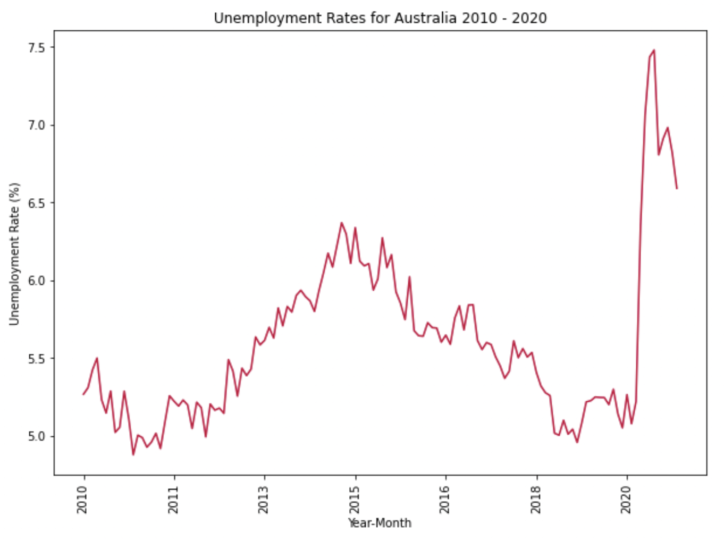
Section 1: Overall analysis of unemployment in Australia (2010-2020)
Notes:
From this data we captured from 2010 - 2020 this shows us the trend over the last 10 years
We can see that end of 2010 the shows that this is our lowest unemployment rate
There was an increase in 2014 - 2015, followed by a steady decline in the overall unemployment rate
This data shows that for the impact of COVID was significant on the unemployment rate

Slide 7
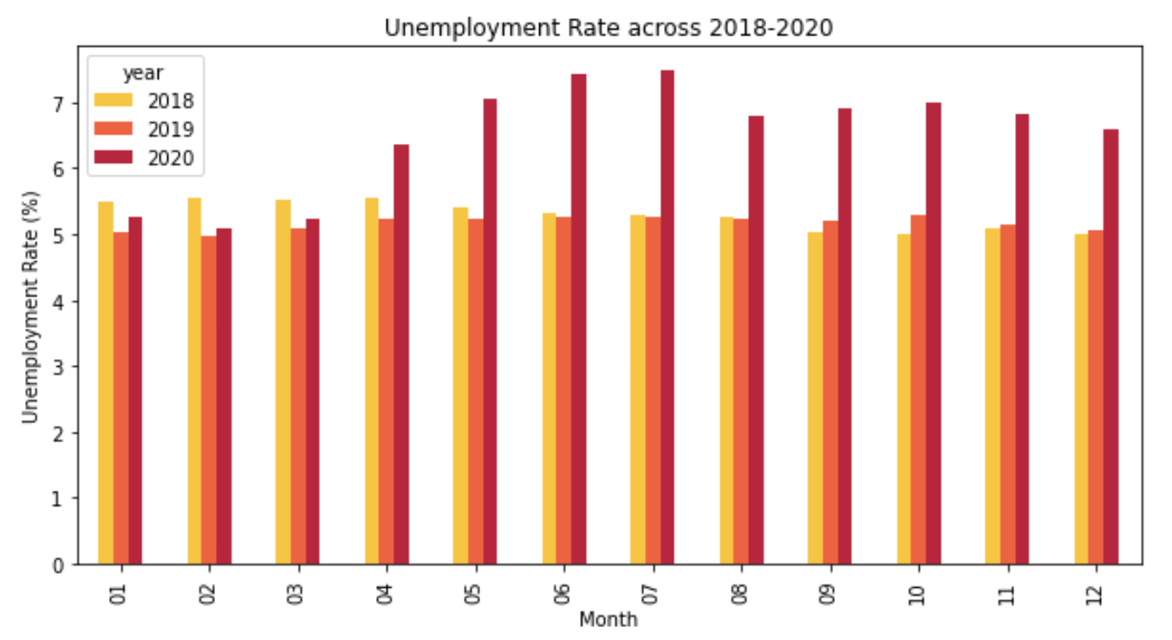
Section 1: Comparison per month of the unemployment rate in the last 3 years
Notes:
2018-2019 the unemployment was similar in the month to month comparison - this is close to the natural unemployment rate of about 5.5%
Due to the impact of Covid impacted all industries, as we can see that the unemployment rate increased based on the impact of lockdown periods and
However overall the unemployment rate did increase rough

Slide 8

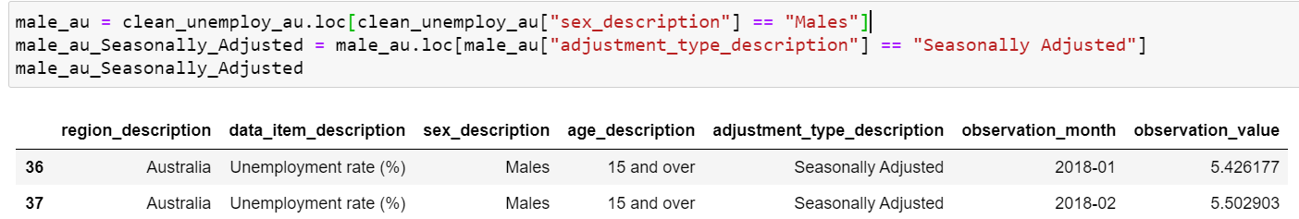
Section 2: The gendered impact of COVID on unemployment from 2018 - 2020
Filter out the data frame based on “gender” and “data adjustment type”
Notes:
Discuss the steps you took to analyze the data and answer each question you asked in your proposal
Present and discuss interesting figures developed during analysis, ideally with the help of Jupyter Notebook

Slide 9

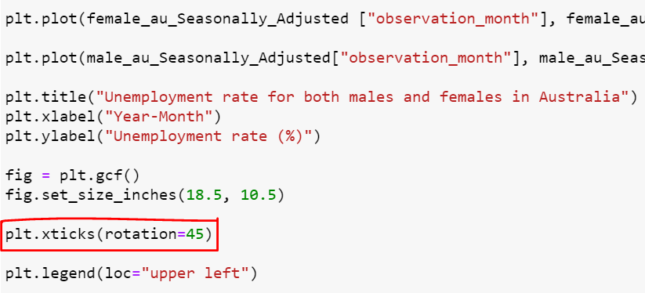
Section 2: The gendered impact of COVID on unemployment from 2018 - 2020
Plot the line graph for gender unemployment rate using pyplot.
Ensure all the months can be seen on the chart.

Slide 10
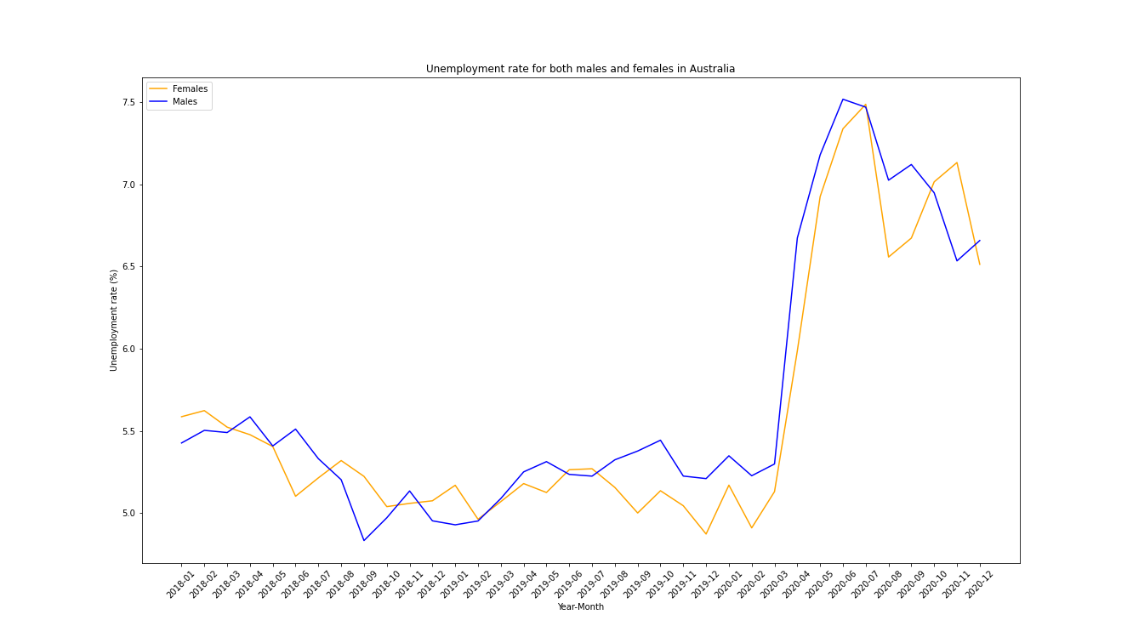
Unemployment rate per gender between 2018 - 2020

Slide 11
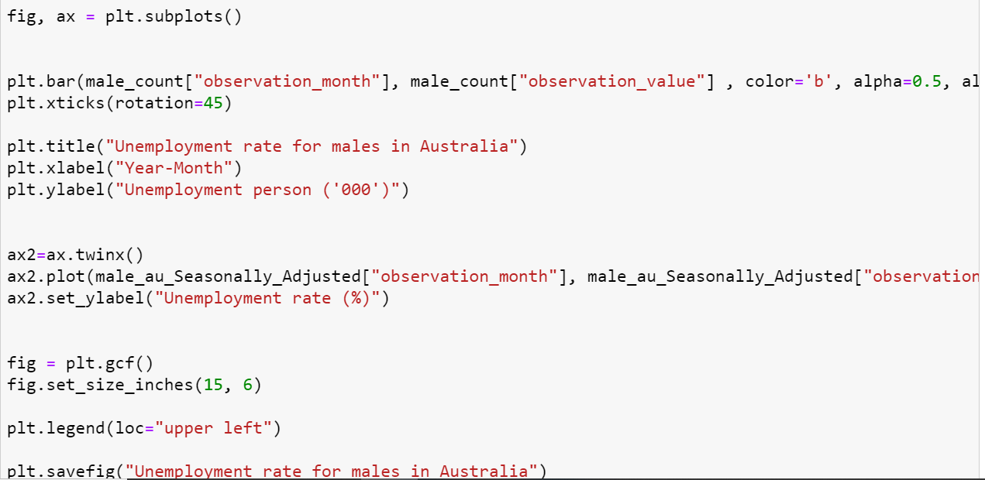
Unemployment rate and persons per gender between 2018 - 2020
Combined the line chart and bar chart for better visual presentation
Adding a second y-axis on the right side with different measurement.

Slide 12
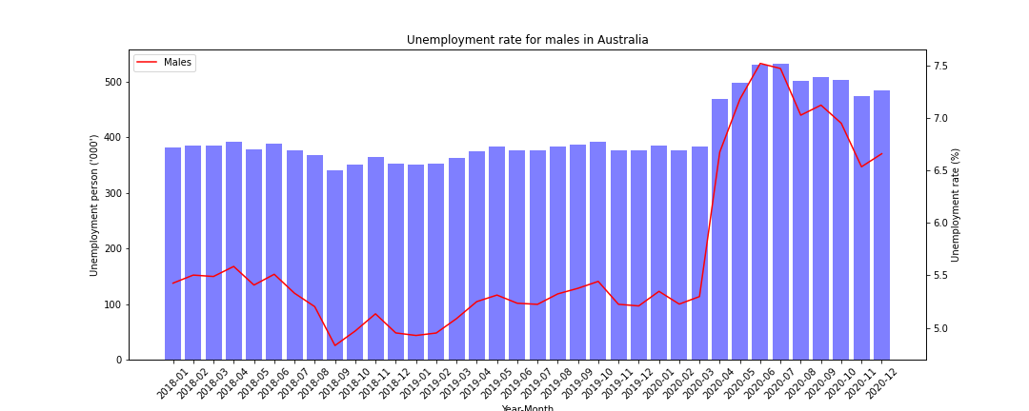
Unemployment rate and number of unemployed males between 2018 - 2020

Slide 13
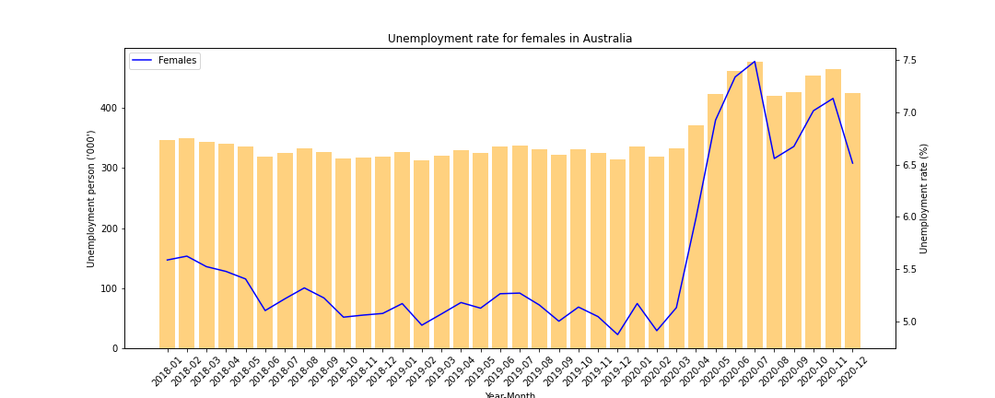
Unemployment rate and number of unemployed females between 2018 - 2020

Slide 14
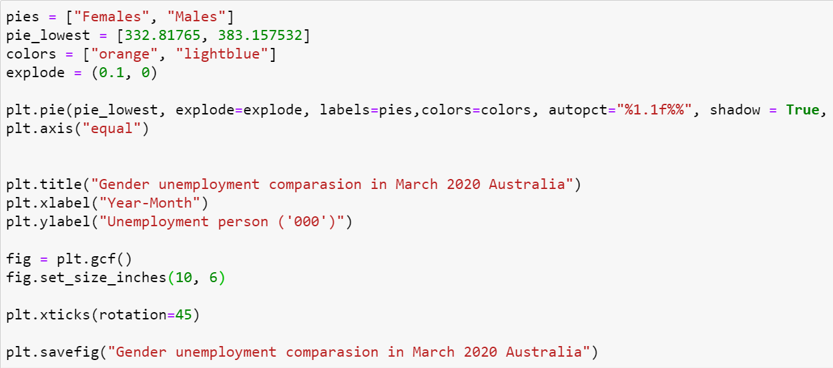

Gender distribution of unemployed persons during 2020

Slide 15

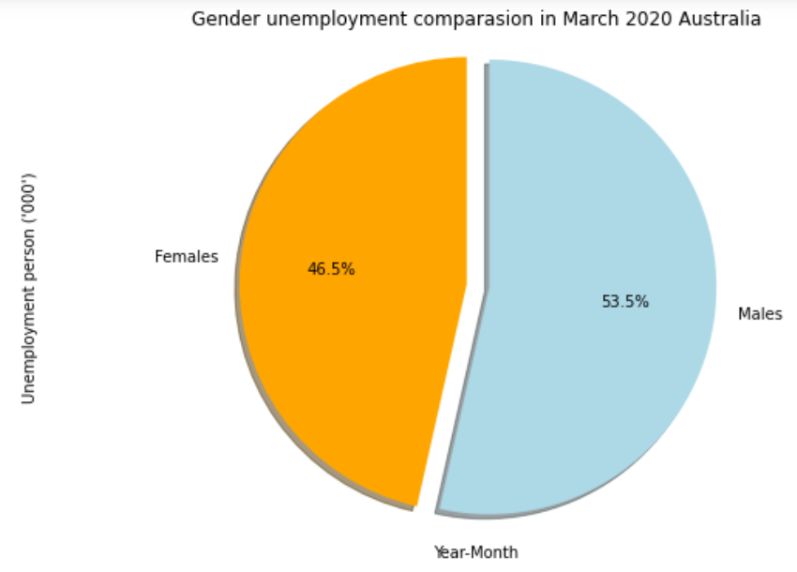
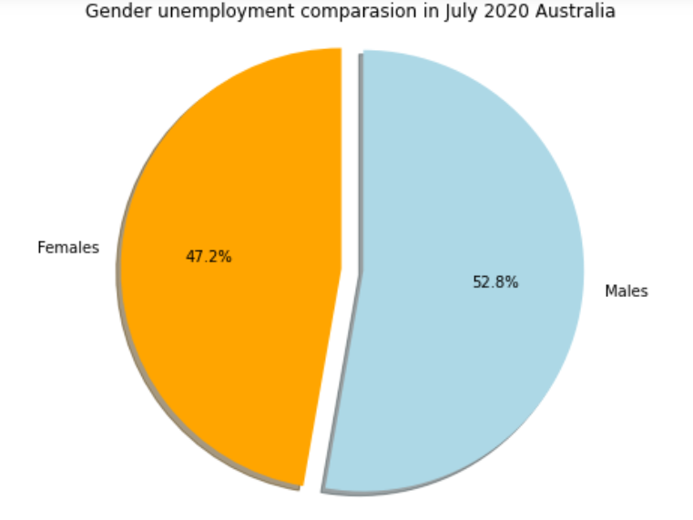
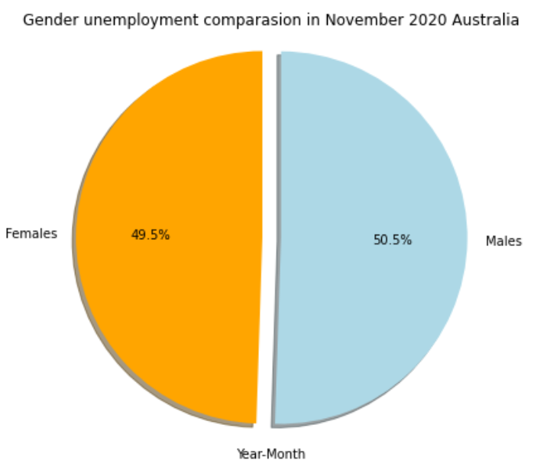

Gender distribution of unemployed persons during 2020
Male unemployment
Female unemployment

Slide 16
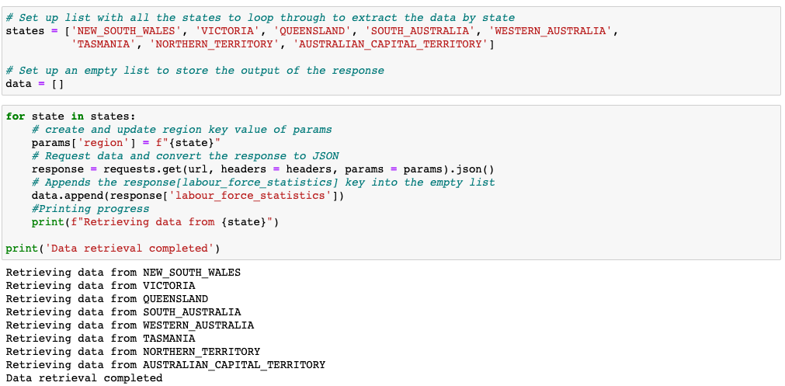
Section 3: The impact of COVID19 on unemployment by states

Slide 17
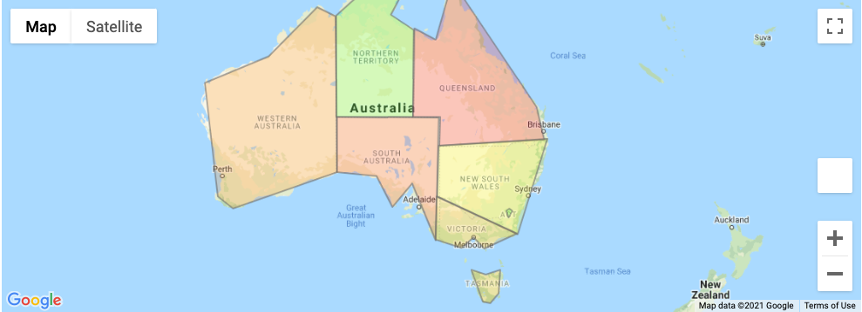
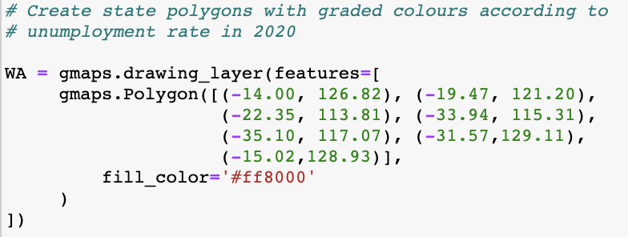
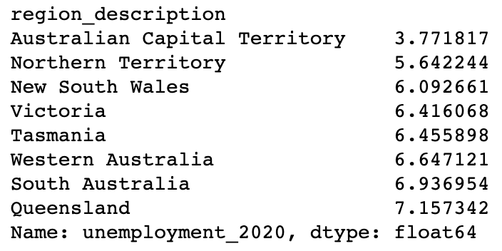

Section 3: Unemployment rate by states in 2020 on a map

Slide 18
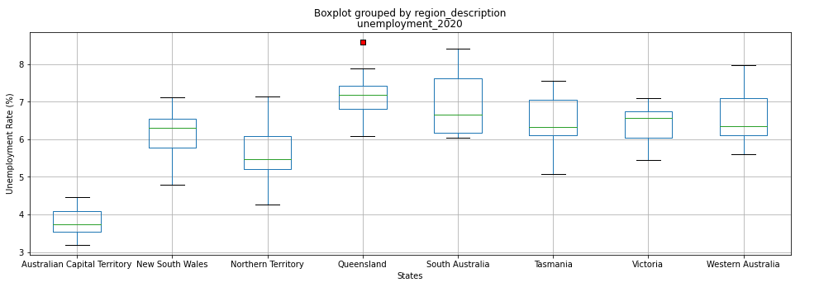
Section 3: Unemployment rate by states in 2020
****

Slide 19
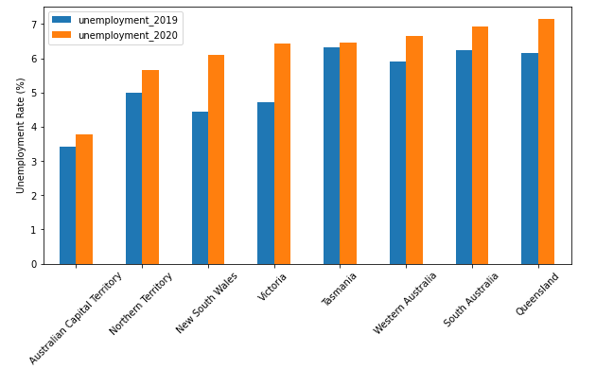
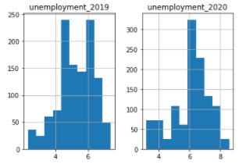
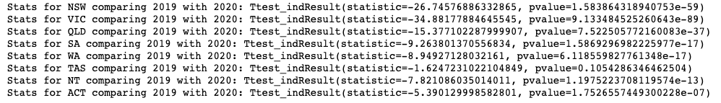
Section 3: The impact of COVID19 on unemployment rate by states
****
****
****
ns
****
****
****
****
Data follows a normal distribution
**** p < 0.001

Slide 20
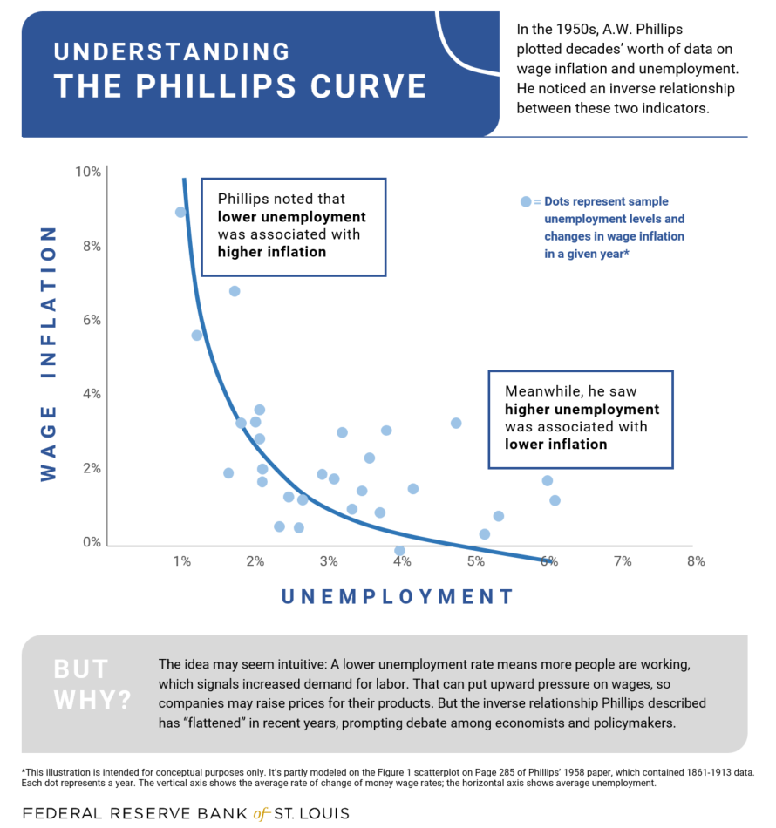
Section 4:
Examining if the original Phillips curve is applicable in this scenario (correlation)

Slide 21
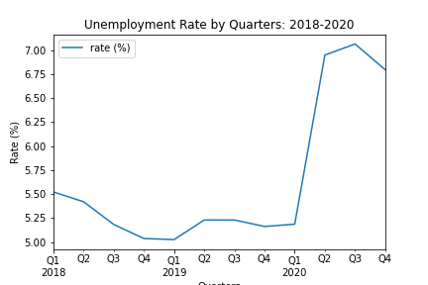
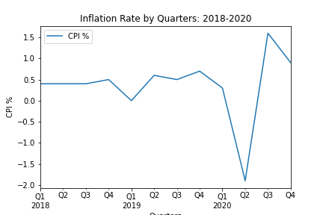
Section 4:
Examining if the original Phillips curve is applicable in this scenario (correlation)
Quarters
Quarters

Slide 22
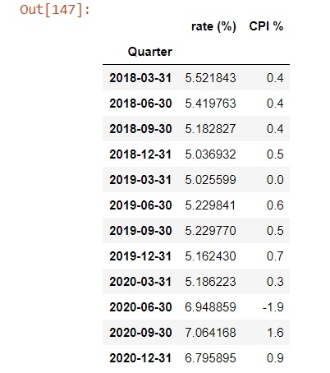
Section 4:
Examining if the original Phillips curve is applicable in this scenario (correlation)
Australia experienced deflation, falling prices . This was the first time inflation has been negative since 1998, and only the third time in the 72-year history of the index, Australian Bureau of Statistics.
Childcare costs tumbled 95% in the June quarter, and the consumer price index was also driven down by steep falls in the cost of petrol, which tumbled 19.3% as demand collapsed and the crude oil price plunged into negative territory, and education, which collapsed by 16.2% after New South Wales, Victoria and Queensland made pre-school free.
Australia has recorded the largest ever quarterly fall in inflation of 1.9% after the Morrison government temporarily made childcare free due to the coronavirus crisis.

Slide 23
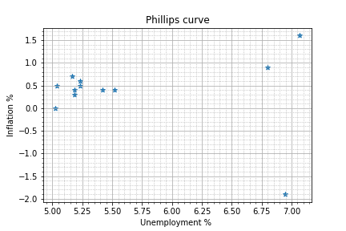
Section 4:
Examining if the original Phillips curve is applicable in this scenario (correlation)

Slide 24
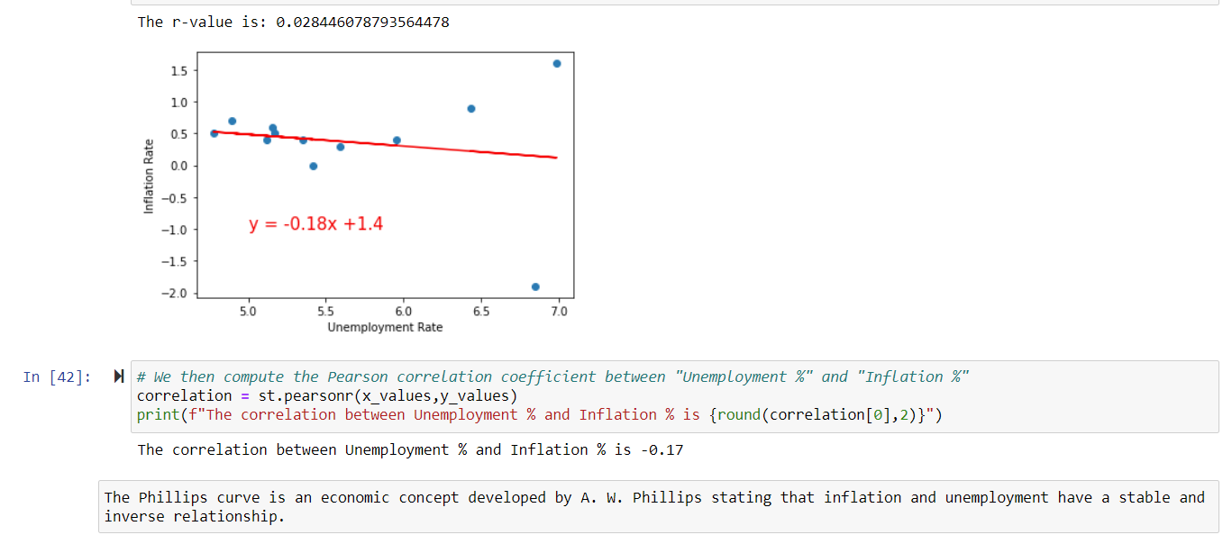

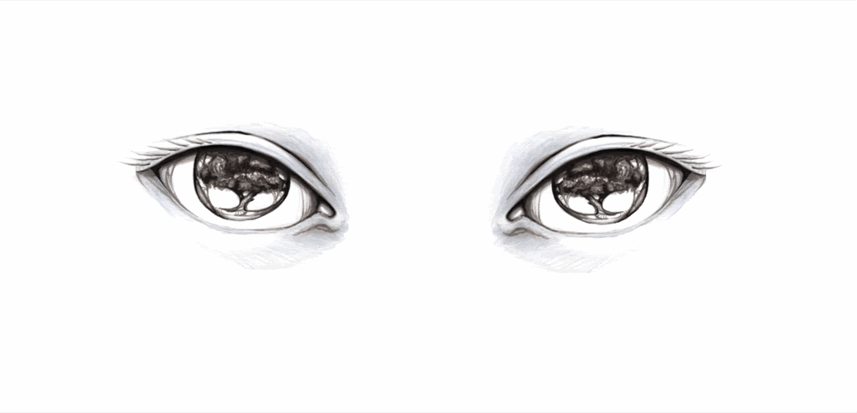

Section 4: Discussion
R-squared value < 0.3 this value is generally considered a None or Very weak effect size
Correlation coefficients are always values between -1 and 1,
where -1 shows a perfect linear negative correlation.
Notes:
Discuss your findings. Did you find what you expected to find? If not, why not? What inferences or general conclusions can you draw from your analysis?

Slide 25


Slide 26
CONCLUSIONS
COVID’s shock on unemployment was significant that dramatically exceed the government’s target unemployment rate goal (below 5%) for the past decade.
Both gender were impacted hugly, male unemployment was gradually reducing during the recovery phase. Data shows the female unemployment experienced an opposite trend, especially when it is close to Christmas period.
Each state’s unemployment were affected dramatically except Tasmania that shows very small changes before and after COVID.
The Phillips curve is not applicable to evaluate the relationship between unemployment rate and inflation rate due to government intervention in this case.
Notes:
Discuss your findings. Did you find what you expected to find? If not, why not? What inferences or general conclusions can you draw from your analysis?
Possible explanation:
Male dominated industry recovered faster than female dominated industry
More females are unwilling to return back to work due to family commitments during school holidays and Christmas season
Job structure changed that no longer needed certain professions (might affect more females than males)

Slide 27
FUTURE DIRECTIONS
How long it would take for the unemployment rate to return below 5%?
What are the factors that cause female unemployment rate to increase at the end of year? Would underemployment able to explain this phenomenon?
What is the reason for COVID19 not impacting equally across states (size of employed persons vs labour force, different job industries, etc)?
What other types of correlation graph we can use to better analyse the relationship between unemployment rate and inflation rate?
Notes:
Discuss your findings. Did you find what you expected to find? If not, why not? What inferences or general conclusions can you draw from your analysis?
Possible explanation:
Male dominated industry recovered faster than female dominated industry
More females are unwilling to return back to work due to family commitments during school holidays and Christmas season
Job structure changed that no longer needed certain professions (might affect more females than males)

Slide 28

Questions

Slide 29


